Slide 1
What To Do Before And After A Flood

Slide 2
Preparing For A Flood
Floods can make your food and water unsafe.
Move canned goods and cooking equipment to a high area if possible.
Flood waters are dangerous to your food because it may contain sewage, dangerous chemicals, and other contaminants.

Slide 3

What To Do After A Flood
Inspect your kitchen and food storage areas.
Look for items that came into
contact with flood waters.
  Some items can be salvaged.
  Other items must be thrown in the garbage.

Slide 4
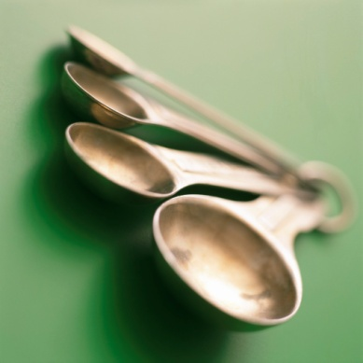
Bleach Solution
Recipe:
  1 tablespoon of household bleach per
  1 gallon of clean water
This is not the recipe for purifying water, it is to be used for cleaning only.
DO NOT DRINK!

Slide 5
Items That Can Be Salvaged
Metal pots, pans, glass or ceramic dishes, and metal utensils.
  Wash in warm soapy water then soak in a bleach solution for 15 minutes.
Counter tops and kitchen surfaces.
  Clean with warm soapy water then sanitize with bleach solution.
Undamaged cans or retort packages.
  Wash and sanitize with bleach solution.

Slide 6
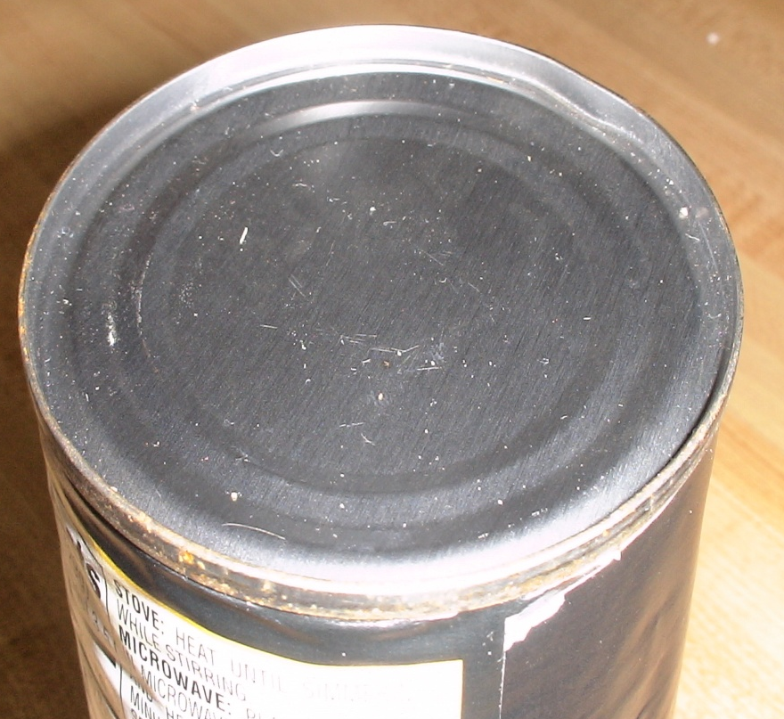
Canned Items And Retort Packages That Cannot Be Salvaged
Canned items with rust or damage to the outside.
  Look to see if the can has swelling.
Retort packages with damaged seams.

Slide 7
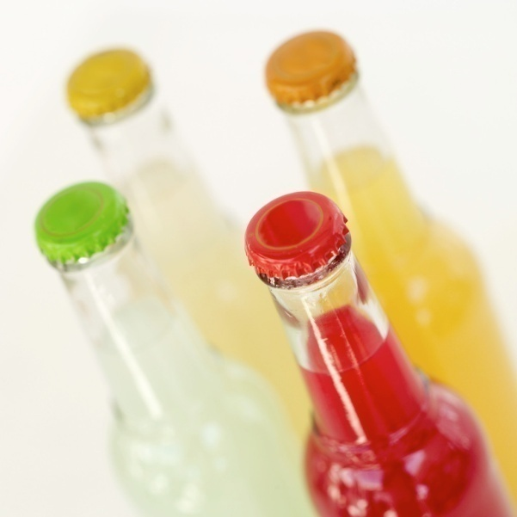
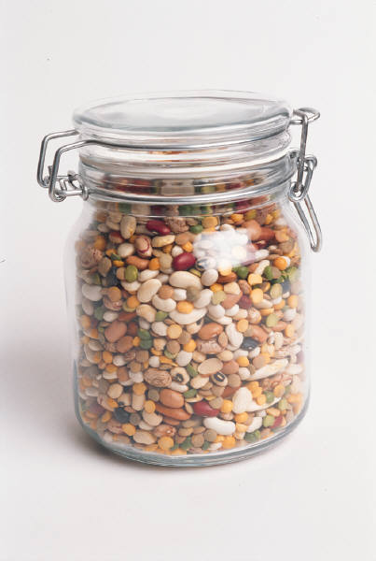
Other Foods
That Cannot Be Salvaged
Food not in a waterproof container.
  Containers with screw caps, snap lids, pop tops, or crimped bottle caps.
  Cardboard cartons and boxes

Slide 8
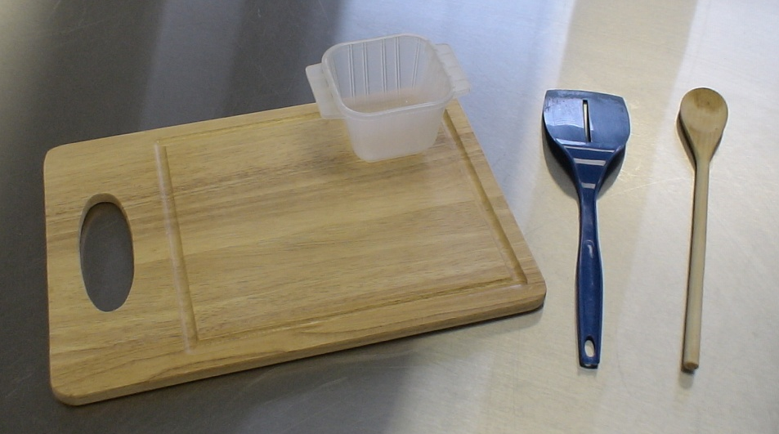
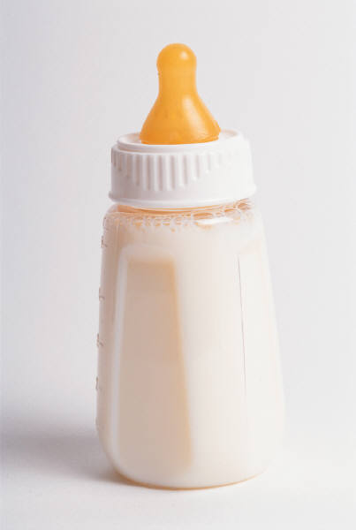
Other Items
That Cannot Be Salvaged
Cutting boards, wooden spoons and bowls, plastic utensils, baby bottle nipples, and pacifiers.

Slide 9
Items That Cannot Be Salvaged continued
Refrigerators and freezers that were under flood waters cannot be salvaged.
Once the insulation material is exposed to flood waters they are no longer safe.

Slide 10

DO NOT EAT OR DRINK ANYTHING THAT HAS COME IN CONTACT WITH FLOOD WATERS.
WHEN IN DOUBT,
THROW IT OUT!

Slide 11
Conclusion
Flood waters are unsafe.
After a flood inspect your kitchen.
Bleach Solution=1 tbs bleach+1 gal water
Items that are salvaged must be cleaned and sanitized.

Slide 12
Conclusion
Inspect all canned and retort food items after a flood.
When In Doubt, Throw It Out!

